Slide 1
Consumer Awareness
!
(Updated June 2025)
Disclaimer: The information presented in this lesson does not constitute legal, tax, investment, financial, or other advice. This lesson is intended as an informational resource to assist you in identifying or exploring resources and options for managing your personal financial situation.

Slide 2
Agenda
Misleading and Fraudulent Practices
Smart Purchases
Identity Theft
Military Consumer Protection
Consumer Awareness

Slide 3
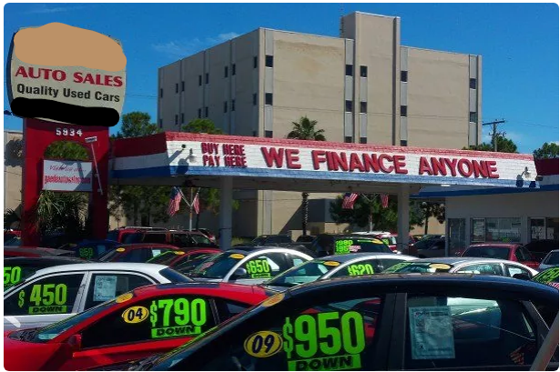



Activity: Military Targeted Ads
Consumer Awareness

Slide 4
Consumer Advertising Techniques
Affinity Marketing
Independence/Individuality
Rebellious
Intelligence
Rhetorical Question
Beauty Appeal
Lifestyle
Scientific/ Statistical Claim
Celebrity Endorsement
Nurture
Unfinished Comparison/Claim
Escape
Peer Approval
Meaningless Terms
Consumer Awareness

Slide 5

Common Schemes Aimed at Consumers
Technological Tools
Misrepresentation
Skimming
ID spoofing
Phishing schemes
Sellers make you believe the deal is different than it really is!
Scams
Frauds
Get-rich-quick deals
Pyramid schemes
Internet scams
Email fraud
Identify theft
Telemarketing fraud
Consumer Awareness

Slide 6

Why Are Service Members Vulnerable?
Steady income
Limited consumer education
Greater financial needs through marriage
Targeted marketing
Consumer Awareness

Slide 7
Tips to Guide Shopping Decisions
Is it a want or need?
Get agreements in writing
Know what you can afford
Too good to be true?
Do your homework
Sleep on it
Check the warranty/guarantee
Picture your future
Consumer Awareness

Slide 8
Advantages and Disadvantages of Payment Options
Cash
Electronic Funds Transfers (EFTs)
Debit Cards
Advantages
  Instant transaction
  No interest
Disadvantages
  No credit building
  Carrying large sums
Advantages
  Transfer money quickly
  Automate payments
Disadvantages
  Timing of transfer
Advantages
  Spending what you already have
Disadvantages
  Potential overdraft fees
Credit Cards
Mobile Payment Apps
Buy Now Pay Later
Advantages
  Purchase protection
  Rewards programs
Disadvantages
  Interest charges
  Can lead to debt
  Annual fees
Advantages
  Quick transactions
  Reduce risk of fraud
Disadvantages
  Not all merchants use mobile payment
  Limited to smartphones
Advantages
  No credit inquiry
Disadvantages
  High fees for late payment
  Doesn’t help build credit
Consumer Awareness

Slide 9

Signs of Identity Theft
Missing bills or statements
Unauthorized transactions or withdrawals
Unexpected calls or letters from debt collectors
Errors on your credit report
Unexplained changes to your credit score
Bills for purchases you did not make
Suspicious activity on your social media or email account
Consumer Awareness

Slide 10
How to Reduce the Risk of Identity Theft
Protect your mail
Opt out of credit offers
Active-duty alerts and credit freezes
Shred what you do not need
Guard your SSN
Sign and carry only what you need
Remove identifying information on social media
Protect your PIN and password
Check receipts and statements
Check your credit annually
Consumer Awareness

Slide 11

Steps to Resolve Identity Theft
Contact company’s fraud department
Close accounts and change passwords
Review your credit report and place a fraud alert
File a police report
File a complaint with the FTC at IdentityTheft.gov
Consumer Awareness

Slide 12

Activity: Deter, Detect, Defend
Match the specific actions to the corresponding Deter, Detect, Defend category.
Deter
Detect
Defend
1. Shredding sensitive documents before discarding them
6. Checking credit reports regularly for errors or suspicious activity​
2. Monitoring bank and credit card statements for unauthorized transactions​
7. Being cautious about sharing personal information online or over the phone​
3. Installing antivirus software and keeping it up to date​
8. Signing up for identity theft protection services​
4. Setting up fraud alerts with credit bureaus​
9. Freezing credit reports to prevent unauthorized access​
5. Using strong, unique passwords for online accounts​
10. Educating oneself about common identity theft scams and tactics​
Consumer Awareness

Slide 13

Military Legal Protections
The Military offers programs to help protect you and your families’ lending rights.
Programs:
Military Lending Act
Servicemembers Civil Relief Act (SCRA)
Consumer Awareness

Slide 14
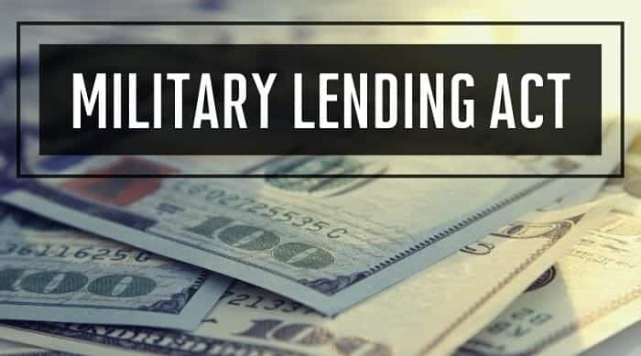
The Military Lending Act (MLA)
Key provisions:
Interest rate cap
Mandatory arbitration prohibited
Restriction on loan terms
Unreasonable notice requirements prohibited
Consumer Awareness

Slide 15
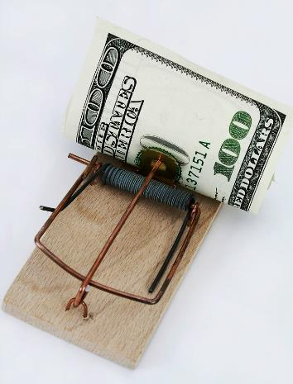
Types of Predatory Lending Practices
Payday Loans
Short-term, high-cost cash loan
Auto-title Loans
Short-term loan using car title as security
Refund Anticipation Loans
High fee, high interest rate loan based on expected tax refund
Consumer Awareness

Slide 16
The Servicemembers
Civil Relief Act (SCRA)
Interest rate cap
Relief from foreclosures
Installment contracts
Lease termination
Stay of proceedings
Income tax deferrals
Termination of cellphone contracts
Vehicle possession protection
Residency for state taxes
Protection from
eviction
Insurance
protections
Consumer Awareness

Slide 17
Federal and State Protections
Federal Protection
Consumer Bill of Rights
Fair Credit Billing Act
7th Amendment
Credit Card Accountability, Responsibility, and Disclosure (CARD) Act
Truth in Lending Act (TILA)
Electronic Fund Transfer Act (EFTA)
State Protection
Lemon laws
State Automobile Repair Facilities Act (SARFA)
Usury laws
Consumer Awareness

Slide 18
Resolving Complaints
Contact the seller
Maintain detailed and organized records
Go to the company president and/or the manufacturer
Contact the appropriate organizations
Use consumer advocate resources
Contact the CFPB
Dispute-resolution programs
Small-claims court
Consumer Awareness

Slide 19

Sources of Support
Personal Financial Managers, Personal Financial Counselors, or Financial Readiness Program Specialists at your local military and family support center
Command/Unit Financial Specialist (USN, USMC, USCG)
Military relief organizations
CFPB Office of Servicemember Affairs
FTC Military Consumer
Installation legal office
Consumer Awareness

Slide 20
Resources
Websites:
Federal Trade Commission
  https://www.militaryconsumer.gov/
Federal Trade Commission Identity theft
  https://www.identitytheft.gov/#/
Consumer Financial Protection Bureau
  https://www.consumerfinance.gov/consumer-tools/educator-tools/servicemembers/
Servicemembers Civil Relief Act
  https://www.justice.gov/servicemembers
Credit reports
  https://www.annualrecreditreport.com
Equifax Military Credit Monitoring
  https://www.equifax.com/personal/military-credit-monitoring
Experian Military Credit Monitoring
  https://www.experian.com/lp/military.html
TransUnion Active-Duty Military Credit Center
  https://www.transunion.com/active-duty-military-credit-center
The Office of Financial Readiness (FINRED)
  https://finred.usalearning.gov
MilitaryOneSource
  https://www.militaryonesource.mil/
Coast Guard Support
  https://www.cgsuprt.com/
Consumer Awareness

Slide 21

Conclusion
Misleading and Fraudulent Practices
Smart Purchases
Identity Theft
Military Consumer Protection Resources
Resources
Consumer Awareness

